Slide 1
PBI Sales Presentation e-commerce
Olist
Developed by David Keating Gomes Mota

Slide 2
- This is a preview of the Power BI Presentation to be downloaded and opened on Power BI Desktop, together with the csv files used to devise it.
Filters (All pages): Time period, State
Cards (All pages): Total Sales, Running Total
- Page 1 – Sales over time (2016-2018) + Sales Forecast (2019)
Page 2 – Running Total Map (interactive) + Top 10 Sales by State
Page 3 – Total Sales by Product Category + Top Sales Products (filter also by category)
Page 4 – Pareto Chart + Overall Table

Slide 3
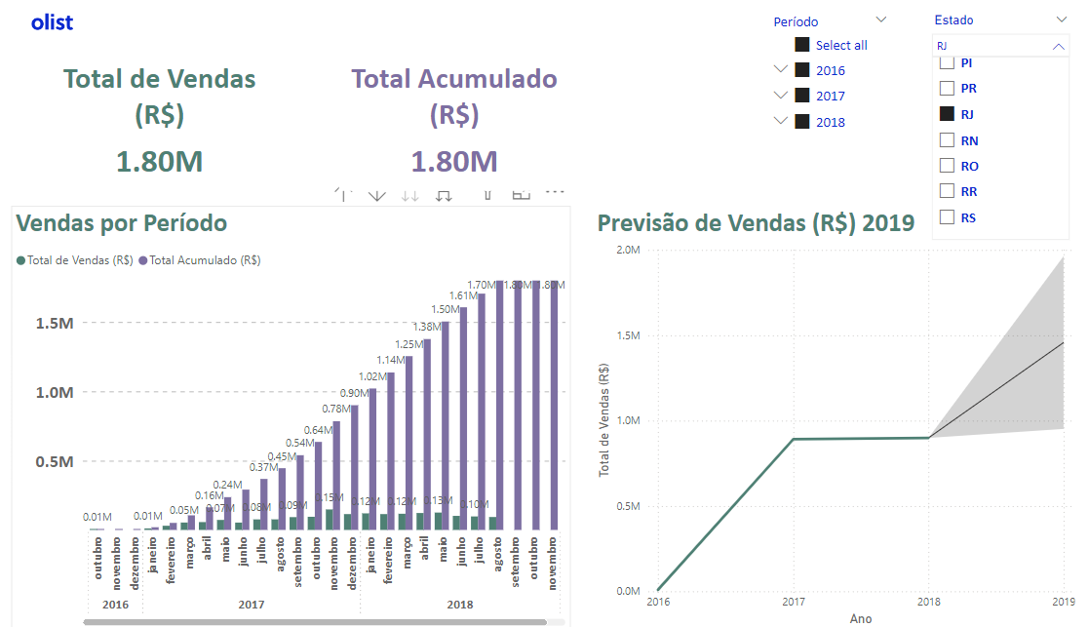

Slide 4
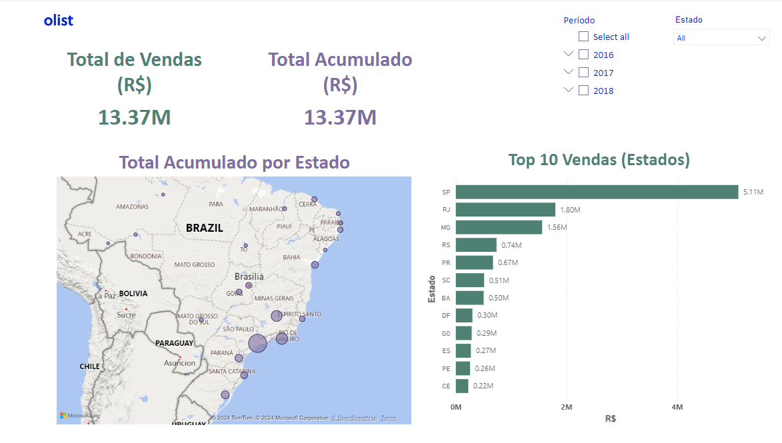

Slide 5
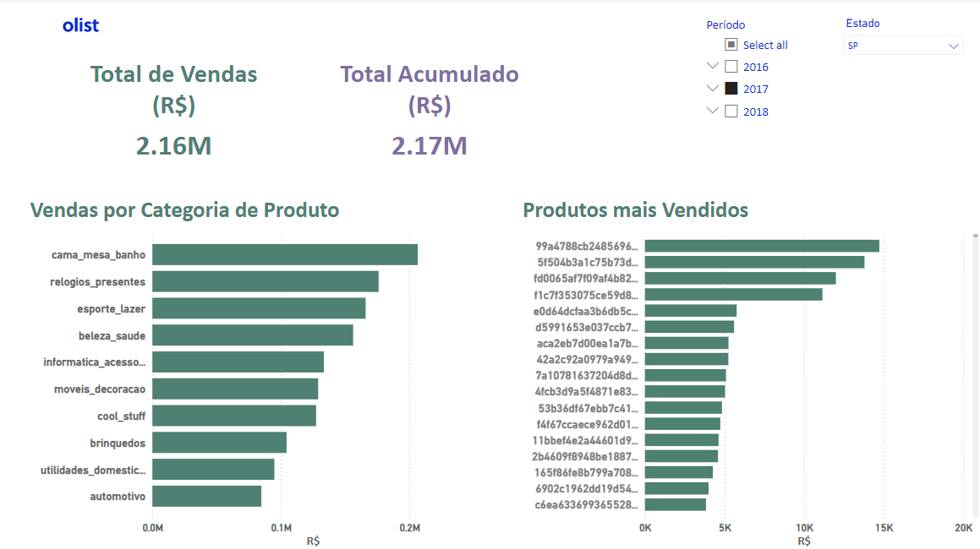

Slide 6
